Slide 1
Key Performance Indicators: Core Measures for 2010-2011
MMSD Strategic Planning –
3rd Annual Update

Slide 2
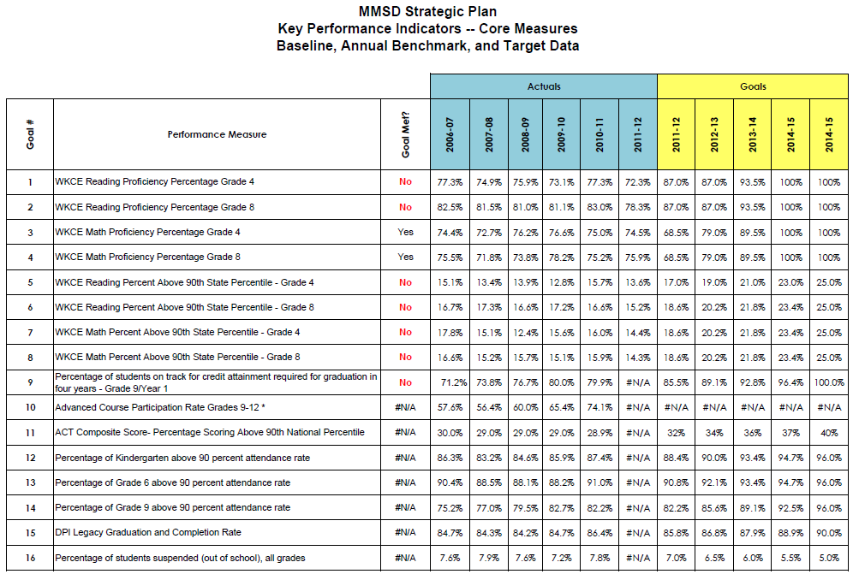
Handout for KPI Core Measures
Sources: WINSS and MMSD records
Notes:
Reconsider using a slide that is unreadable even if there is a handout. Pull key ideas out that you want to communicate and use them as bullets referring to the handout.

Slide 3
Reading Proficiency: Proficient/Advanced 90th Percentile
Grade 4
Grade 8

Slide 4
Source: WINSS, District FAY

Slide 5
Source: WINSS, District FAY

Slide 6
Source: WINSS download file, District FAY

Slide 7
Source: WINSS download file, District FAY

Slide 8
Math Proficiency: Proficient/Advanced 90th Percentile
Grade 4
Grade 8

Slide 9
Source: WINSS, District FAY

Slide 10
Source: WINSS, District FAY

Slide 11
Source: WINSS download file, District FAY

Slide 12
Source: WINSS download file, District FAY

Slide 13
Attendance Rates over 90% Out of School Suspensions
Kindergarten
Grade 6
Grade 9

Slide 14
Source: MMSD records, SQL query

Slide 15
Source: MMSD records, SQL query

Slide 16
Source: MMSD records, SQL query

Slide 17
Source: MMSD records, warehouse table

Slide 18
High School Measures
On Track for Attainment
Advanced Course Participation
Graduation & Completion Rate

Slide 19
Excludes multi-racial students for 2010-11
Source: MMSD records

Slide 20
Source: MMSD records, SQL query

Slide 21
Excludes multi-racial students for 2010-11
Source: WINNS, includes HSED and regular diplomas

